Slide 1

INTELLIGENT AGENTS
CS420 – Artificial Intelligence
Nguyễn Ngọc Thảo
nnthao@fit.hcmus.edu.vn

Slide 2
Outline
Agents and Environments
Good Behavior: The Concept of Rationality
The Nature of Environments
The Structure of Agents

Slide 3
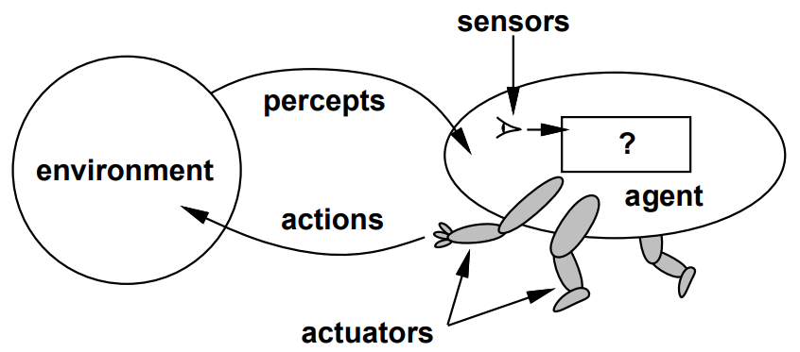
Agents and Environments
Notes:
IA là 1 thực thể có thể nhận biết (perceiving) môi trường quanh nó thông qua các cảm biến (sensor) và tác động lại môi trường thông qua các bộ phận phản ứng lại kích thích (effector /actuator).

Slide 4
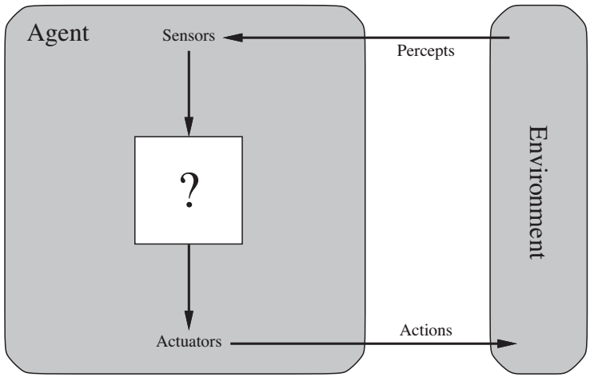
What is Agent?
An agent perceives its environment through sensors and acts upon that environment through actuators.
Agents interact with environments through sensors and actuators.
Notes:
This simple idea is illustrated in Figure 2.1.
IA là 1 thực thể có thể nhận biết (perceiving) môi trường quanh nó thông qua các cảm biến (sensor) và tác động lại môi trường thông qua các bộ phận phản ứng lại kích thích (effector /actuator).

Slide 5



Examples of agent
Human agent
Robotic agent
Software agent
Sensors: eyes, ears, and other organs.
Actuators: hands, legs, vocal tract, etc.
Sensors: cameras, infrared range finders, etc.
Actuators: levels, motors, etc.
Sensors: keystrokes, file contents, network packets, etc.
Actuators: displaying on screen, writing files, sending network packets, etc.

Slide 6
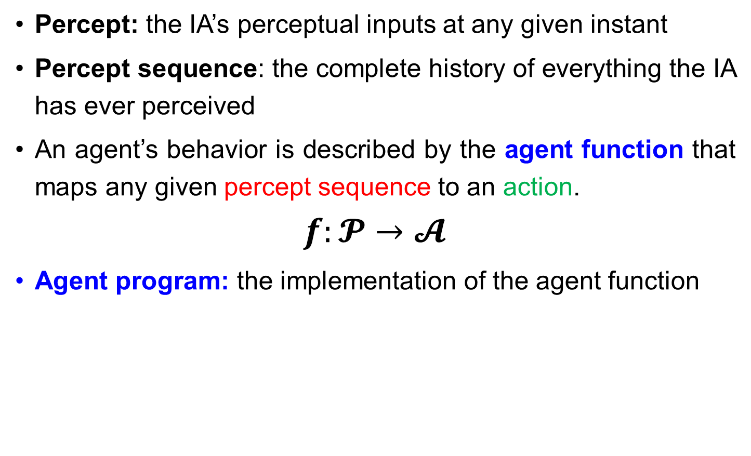
The IA’s behavior
Percept: the IA’s perceptual inputs at any given instant
Percept sequence: the complete history of everything the IA has ever perceived
An agent’s behavior is described by the agent function that maps any given percept sequence to an action.
$$f:𝓟→𝓐$$
Agent program: the implementation of the agent function
agent = architecture + program
mathematical
practical
Notes:
Cảm Nhận : các đầu vào cảm nhận của IA tại bất kỳ thời điểm nào
Chuỗi Cảm Nhận: tất cả các thứ mà IA đã cảm nhận
Hành vi của tác nhân được mô tả bởi hàm tác nhân, ánh xạ chuỗi cảm nhận thành hành động

Slide 7
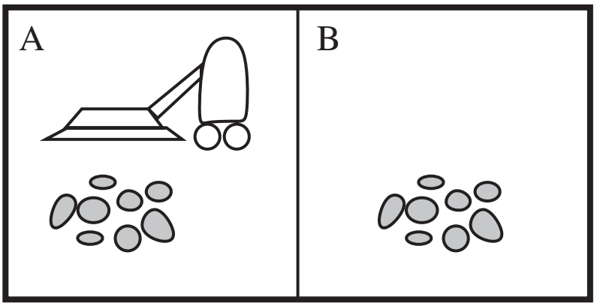
The Vacuum-cleaner world
Percepts: location and contents, e.g., [A,Dirty]
Actions: Left, Right, Suck, Do Nothing
A vacuum-cleaner world with just two locations

Slide 8
The Vacuum-cleaner world
Percept sequence | Action
[A, Clean] | Right
[A, Dirty] | Suck
[B, Clean] | Left
[B, Dirty] | Suck
[A, Clean], [A, Clean] | Right
[A, Clean], [A, Dirty] | Suck
...
...
[A, Clean], [A, Clean], [A, Clean] | Right
[A, Clean], [A, Clean], [A, Dirty] | Suck
Partial tabulation of a simple agent function for the vacuum-cleaner world
Notes:
The agent function can be represented by tabulation.

Slide 9
The Vacuum-cleaner world
function REFLEX-VACUUM-AGENT([location,status]) returns an action
if status = Dirty then return Suck
else if location = A then return Right
else if location = B then return Left
The agent program for a simple reflex agent in the two-state vacuum environment.
Notes:
Looking at Figure 2.3, we see that various vacuum-world agents can be defined simply by filling in the right-hand column in various ways. The obvious question, then, is this: What is the right way to fill out the table? In other words, what makes an agent good or bad, intelligent or stupid? We answer these questions in the next section.

Slide 10

The Concept of Rationality
Rationality
Omniscience, Learning, and Autonomy

Slide 11
Rational agents
A rational agent is one that does the right thing.
  Every entry in the table for the agent function is filled out correctly.
What is “right” thing?
  The actions that cause the agent to be most successful
We need ways to measure success.
Performance measure
Notes:
not an absolute characterization that divides the world into agents and non-agents.
AI operates at (what the authors consider to be) the most interesting end of the spectrum

Slide 12
Performance measure
An agent, based on its percepts → generates actions sequence → environment goes to sequence of states
  If this sequence of states is desirable then the agent performed well
Performance measure evaluates any given sequence of environment states (remember, not agent states!!!).
  An objective function that determines how the agent does successfully.
  90%? 30%?
Notes:
When an agent is plunked down in an environment, it generates a sequence of actions according to the percepts it receives. This sequence of actions causes the environment to go through a sequence of states. If the sequence is desirable, then the agent PERFORMANCE MEASURE has performed well.
If we define success in terms of agent’s opinion of its own performance, an agent could achieve perfect rationality simply by deluding itself that its performance was perfect.
Human agents in particular are notorious for “sour grapes”—believing they did not really want something (e.g., a Nobel Prize) after not getting it.
Obviously, there is not one fixed performance measure for all tasks and agents; typically, a designer will devise one appropriate to the circumstances.

Slide 13
Design performance measures
General rule: Design performance measures according to
What one actually wants in the environment
Not how one thinks the agent should behave
For example, in vacuum-cleaner world
  The amount of dirt cleaned up in a single eight-hour shift, or
  The floor clean, no matter how the agent behaves
  Which one is better?
Notes:
Even when the obvious pitfalls are avoided, there remain some knotty issues to untangle.
For example, the notion of “clean floor” in the preceding paragraph is based on average cleanliness over time. Yet the same average cleanliness can be achieved by two different agents, one of which does a mediocre job all the time while the other cleans energetically but takes long breaks.

Slide 14
Rationality
What is rational at any given time depends on
Performance measure Define the criterion of success | Prior knowledge What the agent knows about the environment
Percept sequence The agent’s percept to date | Actions What the agent can perform

Slide 15

Definition of a rational agent
For example, in an exam,
  Maximize marks based on the questions on the paper and your knowledge
For each possible percept sequence, a rational agent should select an action that is expected to maximize its performance measure, given the evidence provided by the percept sequence and whatever built-in knowledge the agent has.

Slide 16
The Vacuum-cleaner agent
Performance measure
  Awards one point for each clean square at each time step, over 10000 time steps
Prior knowledge about the environment
  The geography of the environment (2 squares)
  The effect of the actions
Actions that can perform
  Left, Right, Suck and Do Nothing
Percept sequences
  Where is the agent?
  Whether the location contains dirt?
Under this circumstance, the agent is rational.
Notes:
The “geography” of the environment is known a priori (Figure 2.2) but the dirt distribution and the initial location of the agent are not.
We claim that under these circumstances the agent is indeed rational; its expected performance is at least as high as any other agent’s. Exercise 2.2 asks you to prove this
The agent would be irrational under other circumstances.
For example, once all the dirt is cleaned up,
The agent will oscillate needlessly back and forth.
A better agent for this case would do nothing
If the performance measure includes a penalty of one point for each movement left or right, the agent will fare poorly.
A better agent for this case would do nothing once it is sure that all the squares are clean.

Slide 17
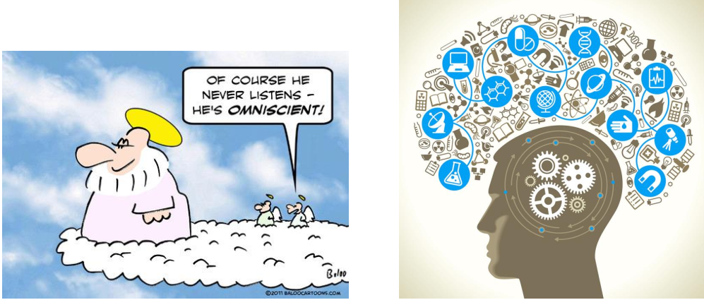
Omniscience, learning, and autonomy

Slide 18

Omniscience vs. Rationality
Omniscience | Rationality
Knows the actual outcome of its actions in advance No other possible outcomes However, impossible in real world Example? | Maximize performance measure given the percepts sequence to date and prior knowledge
Rationality is not perfection
Notes:
I am walking along the Champs Elysees one day and I see an old friend across the street. There is no traffic nearby and I’m not otherwise engaged, so, being rational, I start to cross the street. Meanwhile, at 33,000 feet, a cargo door falls off a passing airliner,2 and before I make it to the other side of the street I am flattened. Was I irrational to cross the street?
This example shows that rationality is not the same as perfection. Rationality maximizes expected performance, while perfection maximizes actual performance.
We must also ensure that we haven’t inadvertently allowed the agent to engage in decidedly underintelligent activities.
For example, if an agent does not look both ways before crossing a busy road, then its percept sequence will not tell it that there is a large truck approaching at high speed.
Rationality maximizes expected performance, while perfection maximizes actual performance.

Slide 19

Information gathering
The agent must not engage in unintelligent activities due to inadvertency.
Information gathering – Doing actions in order to modify future percepts
  E.g. exploration
This is an important part of rationality.
Notes:
We must also ensure that we haven’t inadvertently allowed the agent to engage in decidedly underintelligent activities.
For example, if an agent does not look both ways before crossing a busy road, then its percept sequence will not tell it that there is a large truck approaching at high speed.

Slide 20


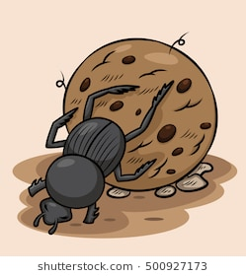
Learning
A rational agent also has to learn as much as possible from what it perceives.
  The agent’s initial configuration may be modified and augmented as it gains experience.
There are extreme cases in which the environment is completely known a priori.
Notes:
The agent’s initial configuration could reflect some prior knowledge of the environment. As the agent gains experience this may be modified and augmented.
There are extreme cases in which the environment is completely known a priori. In such cases, the agent need not perceive or learn; it simply acts correctly. Of course, such agents are fragile. Consider the lowly dung beetle. After digging its nest and laying its eggs, it fetches a ball of dung from a nearby heap to plug the entrance. If the ball of dung is removed from its grasp en route, the beetle continues its task and pantomimes plugging the nest with the nonexistent dung ball, never noticing that it is missing.

Slide 21

Autonomy
A rational agent should be autonomous – Learn what it can to compensate for partial or incorrect prior knowledge.
  If an agent just relies on the prior knowledge of its designer rather than its own percepts then the agent lacks autonomy.
  E.g., a clock
    No input (percepts)
    Run its own algorithm (prior knowledge)
    No learning, no experience, etc.

Slide 22
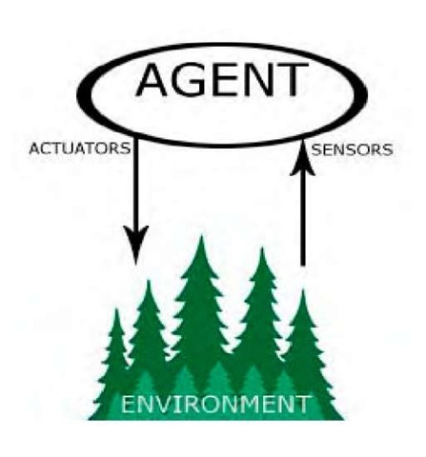
The Nature of Environments
Specifying the Task Environment
Properties of Task Environments

Slide 23
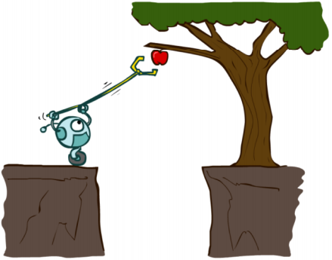
The task environment
Task environments are essentially the “problems” to which rational agents are the “solutions.”
They come in a variety of flavors, which directly affects the appropriate design for the agent program.
Environments
Rational agents
Problems – Solutions

Slide 24
The task environment
The task environment includes
In designing an agent, the first step must always be to specify the task environment (PEAS) as fully as possible.
Performance measure
Environment
Agent’s Actuators
Agent’s Sensors
PEAS

Slide 25







An example: Automated taxi driver
Performance measure
  How can we judge the automated driver?
  Which factors are considered?
    getting to the correct destination
    minimizing fuel consumption
    minimizing the trip time and/or cost
    minimizing the violations of traffic laws
    maximizing the safety and comfort
    etc.
Notes:
The vacuum world was a simple example; let us consider a more complex problem
We should point out, before the reader becomes alarmed, that a fully automated taxi is currently somewhat beyond the capabilities of existing technology. The full driving task is extremely open-ended.
Obviously, some of these goals conflict, so tradeoffs will be required.

Slide 26
An example: Automated taxi driver
Environment
  A taxi must deal with a variety of roads (rural lane, urban alley, etc.)
  Traffic lights, other vehicles, pedestrians, stray animals, road works, police cars, puddles, potholes, etc.
  Interact with the passengers
Actuators (for outputs)
  Control over the accelerator, steering, gear, shifting and braking
  A display to communicate with the customers
Sensors (for inputs)
  Controllable cameras for detecting other vehicles, road situations
  GPS (Global Positioning System) to know where the taxi is
  Many more devices are necessary: speedometer, accelerometer, etc.
Notes:
The taxi might need to operate in Southern California, where snow
is seldom a problem, or in Alaska, where it seldom is not. It could always be driving on the
right, or we might want it to be flexible enough to drive on the left when in Britain or Japan.
Obviously, the more restricted the environment, the easier the design problem

Slide 27
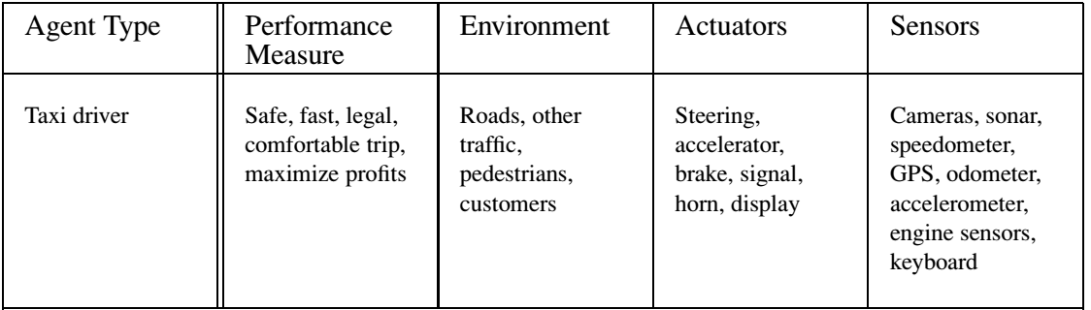
An example: Automated taxi driver
PEAS description of the task environment for an automated taxi.

Slide 28


Software agents
Sometimes, the environment may not be the real world.
  E.g., flight simulator, video games, Internet
  They are all artificial but very complex environments
Those agents working in these environments are called software agent (softbots).
  All parts of the agent are software.
Notes:
Some “real” environments are actually quite simple. For example, a robot designed to inspect parts as they come by on a conveyor belt can make use of a number of simplifying assumptions: that the lighting is always just so, that the only thing on the conveyor belt will be parts of a kind that it knows about, and that only two actions (accept or reject) are possible.
Imagine a softbot Web site operator designed to scan Internet news sources and show the interesting items to its users, while selling advertising space to generate revenue. To do well, that operator will need some natural language processing abilities, it will need to learn what each user and advertiser is interested in, and it will need to change its plans dynamically—for example, when the connection for one news source goes down or when a new one comes online.

Slide 29
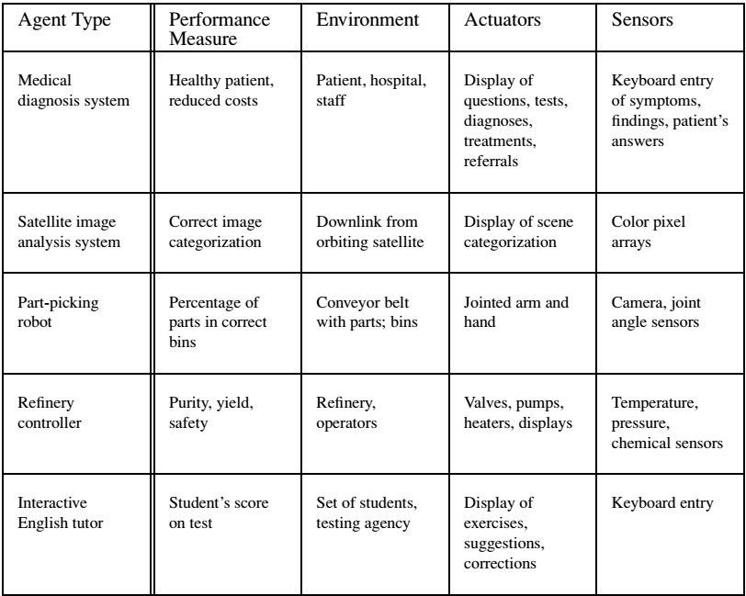
Agents and their PEAS descriptions
Examples of agent types and their PEAS description

Slide 30
Quiz: PEAS description
For each of the following activities, give a PEAS description of the task environment
  Playing a tennis match
  Practicing tennis against a wall
Notes:
Fully observable, stochastic, episodic (every point is separate), dynamic, continuous, multi-agent.
Fully observable, stochastic, episodic, dynamic, continuous, single agent
Playing a tennis match
P Attaining highest score to win the match
E Rackets, net, referee, ball, players
A Human body
S Eyes, ears
Practicing tennis against a wall
P Keeping good form
E Wall, racket, ball
A Human body
S Eyes, ears

Slide 31
Properties of Task environment
Fully observable | Partially observable
Single agent | Multiagent
Deterministic | Stochastic
Episodic | Sequential
Static | Dynamic
Discrete | Continuous
Known | Unknown
These dimensions determine the appropriate agent design and the applicability of techniques for agent implementation
Notes:
The range of task environments that might arise in AI is obviously vast. We can, however, identify a fairly small number of dimensions along which task environments can be categorized.

Slide 32
Fully Observable vs. Partially observable
Fully observable: The agent’s sensory gives it access to the complete state of the environment.
  The agent need not maintain internal state to keep track of the world.
Partially observable
  Noisy and inaccurate sensors
  Parts of the state are simply missing from the sensor data, e.g., a vacuum agent with only a local dirt sensor cannot tell whether there is dirt in other squares
Unobservable: The agent has no sensors at all
Notes:
A task environment is effectively fully observable if the sensors detect all aspects that are relevant to the choice of action; relevance, in turn, depends on the performance measure
E.g. partially: an automated taxi cannot see what other drivers are thinking
If the agent has no sensors at all then the environment is UNOBSERVABLE. One might think that in such cases the agent’s plight is hopeless, but, as we discuss in Chapter 4, the agent’s goals may still be achievable, sometimes with certainty.

Slide 33
Single agent vs. Multiagent
Single agent: An agent operates by itself in an environment.
  E.g., solving crossword → single-agent, playing chess → two-agent
Which entities must be viewed as agents?
  Whether B’s behavior is described as maximizing a performance measure whose value depends on A’s behavior.
Competitive vs. Cooperative multiagent environment
  E.g., playing chess → competitive, driving on road → cooperative
Notes:
Chess is a competitive multiagent environment.
In the taxi-driving environment, on the other hand, avoiding collisions maximizes the performance measure of all agents, so it is a partially cooperative multiagent environment. It is also partially competitive because, for example, only one car can occupy a parking space.

Slide 34
Deterministic vs. Stochastic
Deterministic: The next state of the environment is completely determined by the current state and the action executed by the agent.
  E.g., the vacuum world → deterministic, driving on road → stochastic
Most real situations are so complex that they must be treated as stochastic.
Notes:
If the environment is partially observable, however, then it could appear to be stochastic.
Taxi driving is clearly stochastic in this sense, because one can never predict the behavior of traffic exactly; moreover, one’s tires blow out and one’s engine seizes up without warning.
A nondeterministic environment is one in which actions are characterized by their possible outcomes, but no probabilities are attached to them.Nondeterministic environment descriptions are usually associated with performance measures that require the agent to succeed for all possible outcomes of its actions.

Slide 35
Episodic vs. Sequential
Episodic: The agent’s experience is divided into atomic episodes, in each of which the agent receives a percept and then performs a single action.
  Quality of action depends just on the episode itself
  Do not need to think ahead
Sequential: A current decision could affect future decisions.
For example,
  Spotting defective parts on an assembly line vs. playing chess
Notes:
Many classification tasks are episodic. For example, an agent that has to spot defective parts on an assembly line bases each decision on the current part, regardless of previous decisions; moreover, the current decision doesn’t affect whether the next part is defective.

Slide 36
Static vs. Dynamic
Static: The environment is unchanged while an agent is deliberating.
  E.g., crossword puzzles → static, taxi driving → dynamic
Semidynamic: The environment itself does not change with the passage of time but the agent’s performance score does
  E.g., chess playing with a clock
Notes:
Static environments are easy to deal with because the agent need not keep looking at the world while it is deciding on an action, nor need it worry about the passage of time. Dynamic environments, on the other hand, are continuously asking the agent what it wants to do; if it hasn’t decided yet, that counts as deciding to do nothing.

Slide 37
Properties of Task environment
Discrete vs. continuous
  The distinction applies to the state of the environment, to the way time is handled, and to the agent’s percepts and actions
  E.g., the chess has a finite number of distinct states, percepts and actions; while the vehicles’ speeds and locations sweep through a range of continuous values smoothly over time.
Known vs. unknown
  Known environment: the outcomes (or outcome probabilities if the environment is stochastic) for all actions are given.
  Unknown environment: the agent needs to learn how it works to make good decisions.

Slide 38
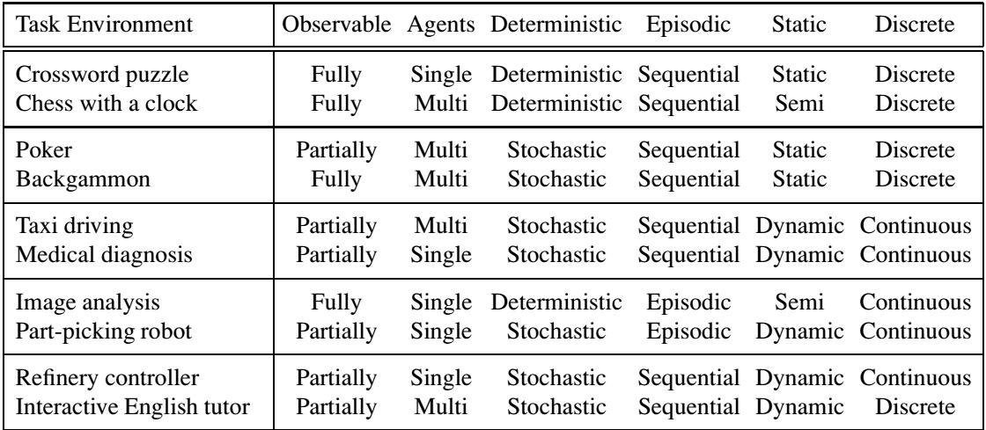
Environments and their characteristics
Examples of task environments and their characteristics.

Slide 39
Properties of Task environment
The simplest environment: Fully observable, deterministic, episodic, static, discrete and single-agent.
Most real situations: Partially observable, stochastic, sequential, dynamic, continuous and multi-agent.
Notes:
Taxi driving is hard in all these senses, except that for the most part the driver’s environment is known.
Driving a rented car in a new country with unfamiliar geography and traffic laws is a lot more exciting

Slide 40
Quiz: Properties of Task environment
For each of the following activities, characterize its task environment in term of properties listed.
  Playing a tennis match
  Practicing tennis against a wall
Notes:
Fully observable, stochastic, episodic (every point is separate), dynamic, continuous, multi-agent.
Fully observable, stochastic, episodic, dynamic, continuous, single agent

Slide 41
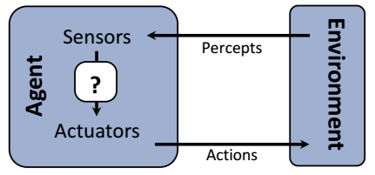
The Structure of Agents
Agent Programs
Simple Reflex Agents
Model-based Reflex Agents
Goal-based Agents
Utility-based Agents
Learning Agents

Slide 42
The agent architecture
Architecture: some sort of computing device with physical sensors and actuators that this program will run on.
  Ordinary PC, robotic car with several onboard computers, cameras, and other sensors, etc.
The program has to be appropriate for the architecture.
  Program: Walk action → Architecture: legs
agent = architecture + program
Notes:
Agent program implement the agent function, which is the mapping from percepts to actions.
In general, the architecture makes the percepts from the sensors available to the program, runs the program, and feeds the program’s action choices to the actuators as they are generated

Slide 43
The agent programs
Input for Agent Program
  Only the current percept
Input for Agent Function
  The entire percept sequence
  The agent must remember all of them
Implement the agent program as
  A look up table (agent function)
Notes:
Notice the difference between the agent program, which takes the current percept as input, and the agent function, which takes the entire percept history.
The agent program takes just the current percept as input because nothing more is available from the environment; if the agent’s actions need to depend on the entire percept sequence, the agent will have to remember the percepts.

Slide 44
The agent programs
A trivial agent program: keep track of the percept sequence and index into a table of actions to decide what to do.
function TABLE-DRIVEN-AGENT(percept) returns an action
persistent: percepts, a sequence, initially empty
table, a table of actions, indexed by percept sequences, initially fully specified
append percept to the end of percepts
action ← LOOKUP(percepts, table)
return action
The TABLE-DRIVEN-AGENT program is invoked for each new percept and
returns an action each time. It retains the complete percept sequence in memory.

Slide 45
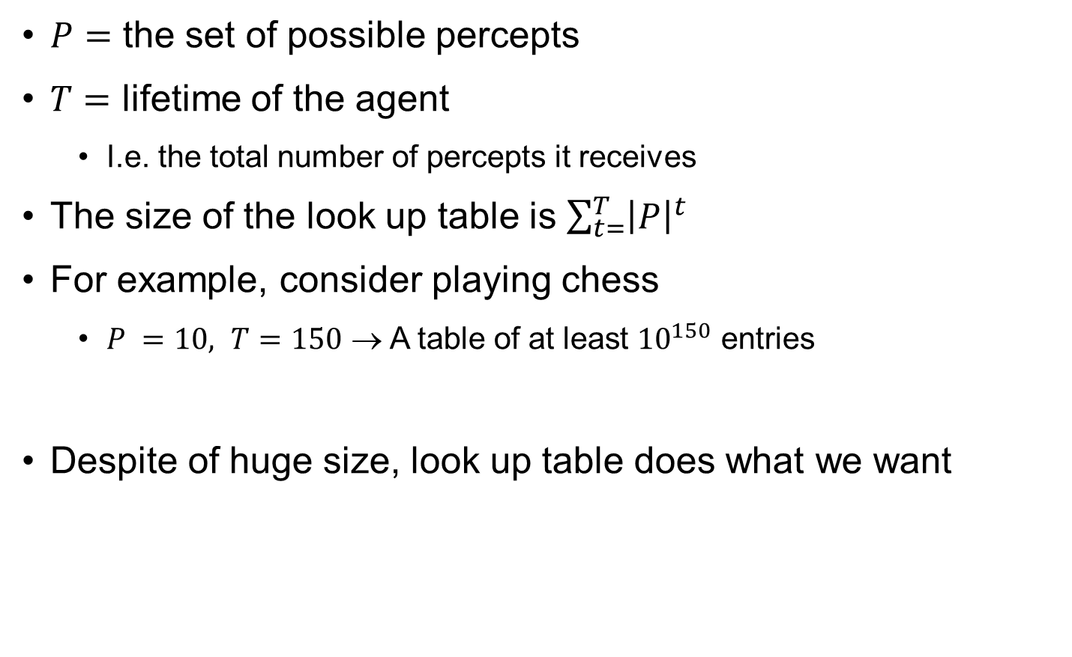
The agent programs
$P=$ the set of possible percepts
$T=$ lifetime of the agent
  I.e. the total number of percepts it receives
The size of the look up table is $\sum_{t=}^{T}{{\left|P\right|}^{t}}$
For example, consider playing chess
  $P =10, T=150$ → A table of at least ${10}^{150}$ entries
Despite of huge size, look up table does what we want

Slide 46
The key challenge of AI
Find out how to write programs that, to the extent possible, produce rational behavior from a small amount of code rather than a large amount of table entries
  E.g., a five-line program of Newton’s Method vs. huge tables of square roots,…

Slide 47
Types of agent programs
Agents
Simple reflex
agents
Model-based reflex agents
Goal-based agents
Utility-based agents
Notes:
Each kind of agent program combines particular components in particular ways to generate actions

Slide 48
Simple reflex agents
The simplest kind of agent, but of limited intelligence
Select actions based on the current percept, ignoring the rest of the percept history
The connection from percept to action is represented by condition-action rules.
IF current percept THEN action
  E.g., IF car-in-front-is-braking THEN initiate-braking.
Limitations
  Knowledge sometimes cannot be stated explicitly → low applicability
  Work only if the environment is fully observable
Notes:
For example, the vacuum agent whose agent function is tabulated in Figure 2.3 is a simple reflex agent, because its decision is based only on the current location and on whether that location contains dirt.
Notice that the vacuum agent program is very small indeed compared to the corresponding table. The most obvious reduction comes from ignoring the percept history, which cuts down the number of possibilities from 4^T to just 4.
A further, small reduction comes from the fact that when the current square is dirty, the action does not depend on the location.
The agent in Figure 2.10 will work only if the correct decision can be made on the basis of only the current percept—that is, only if the environment is fully observable. Even a little bit of unobservability can cause serious trouble.
For example, the braking rule given earlier assumes that the condition car-in-front-is-braking can be determined from the current percept—a single frame of video. This works if the car in front has a centrally mounted brake light. Unfortunately, older models have different configurations of taillights, brake lights, and turn-signal lights, and it is not always possible to tell from a single image whether the car is braking. A simple reflex agent driving behind such a car would either brake continuously and unnecessarily, or, worse, never brake at all.

Slide 49
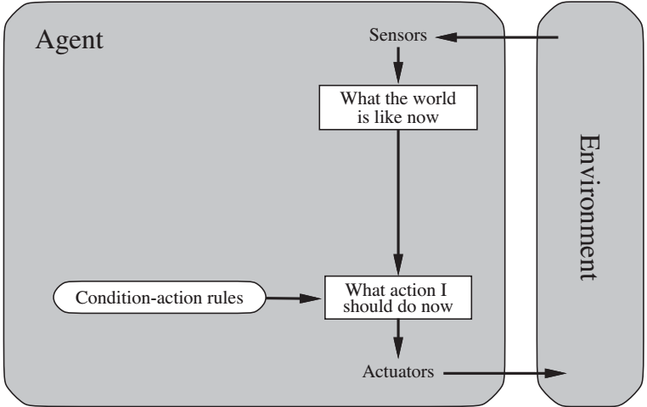
function SIMPLE-REFLEX-AGENT(percept) returns an action
persistent: rules, a set of condition–action rules
state ← INTERPRET-INPUT(percept)
rule ← RULE-MATCH(state, rules)
action ← rule.ACTION
return action

Slide 50


A Simple reflex agent in nature
percepts
(size, motion)
Action: SNAP or AVOID or NOOP
RULES:
(1) If small moving object, then activate SNAP
(2) If large moving object, then activate AVOID and inhibit SNAP
ELSE (not moving) then NOOP
Needed for completeness

Slide 51
Model-based reflex agents
Partially observability → the agent has to keep track of an internal state
  Depend on the percept history and reflect some of the unobserved aspects
  E.g., driving a car and changing lane
The agent program updates the internal state information as time goes by by encoding two kinds of knowledge
  How the world evolves independently of the agent
  How the agent’s actions affect the world
model of the world
Notes:
For the braking problem, the internal state is not too extensive— just the previous frame from the camera, allowing the agent to detect when two red lights at the edge of the vehicle go on or off simultaneously.
Updating the internal state information as time goes by requires two kinds of knowledge to be encoded in the agent program.
For example, that an overtaking car generally will be closer behind than it was a moment ago
For example, that when the agent turns the steering wheel clockwise, the car turns to the right, or that after driving for five minutes northbound on the freeway, one is usually about five miles north of where one was five minutes ago

Slide 52
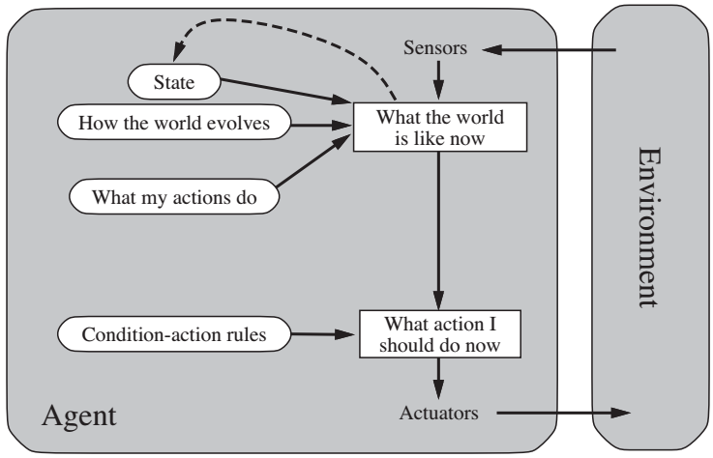
IF | THEN
Saw an object ahead and turned right, and it’s now clear ahead | Go straight
Saw an object ahead and turned right, and object ahead again | Halt
See no object ahead | Go straight
See an object ahead | Turn randomly
Example table agent with internal state

Slide 53
Goal-based agents
Current state of the environment is always not enough
The agent further needs some sort of goal information that describes situations that are desirable.
  E.g., at a road junction, the taxi can turn left, turn right, or go straight on, depending on where the taxi is trying to get to.
Less efficient but more flexible
  Knowledge that supports the decisions is represented explicitly and can be modified
Notes:
For example, at a road junction, the taxi can turn left, turn right, or go straight on. The correct decision depends on where the taxi is trying to get to.
Sometimes goal-based action selection is straightforward—for example, when goal satisfaction results immediately from a single action. Sometimes it will be more tricky—for
example, when the agent has to consider long sequences of twists and turns in order to find a way to achieve the goal. Search (Chapters 3 to 5) and planning (Chapters 10 and 11) are the subfields of AI devoted to finding action sequences that achieve the agent’s goals.
If it starts to rain, the agent can update its knowledge of how effectively its brakes will operate; this will automatically cause all of the relevant behaviors to be altered to suit the new conditions. For the reflex agent, on the other hand, we would have to rewrite many condition–action rules. The goal-based agent’s behavior can easily be changed to go to a different destination, simply by specifying that destination as the goal. The reflex agent’s rules for when to turn and when to go straight will work only for a single destination; they must all be replaced to go somewhere new

Slide 54
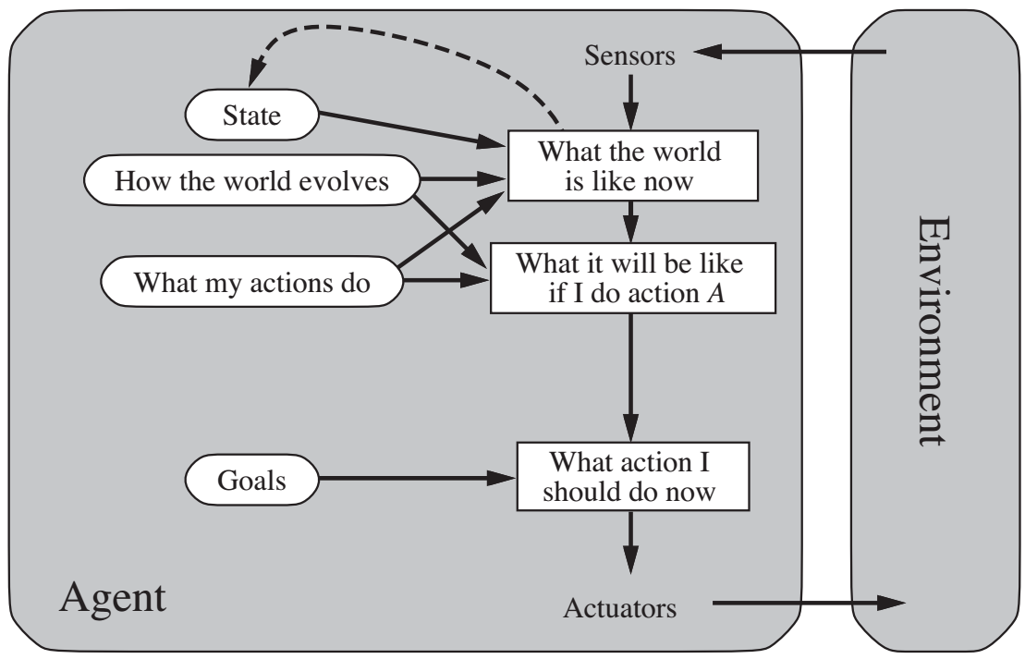
Goal-based agents
Notes:
A model-based, goal-based agent. It keeps track of the world state as well as a set of goals it is trying to achieve, and chooses an action that will (eventually) lead to the achievement of its goals.

Slide 55
Utility-based agent
Goals alone are not enough to generate high-quality behavior in most environments
  Many action sequences to get the goals, some are better and some worse
  E.g., go home: Vinasun taxi or Grab car?
An agent’s utility function is essentially an internalization of the performance measure.
  Goal → success, utility → degree of success (how successful it is)
  If state A is more preferred than others then A has higher utility
Notes:
For example, many action sequences will get the taxi to its destination (thereby achieving the goal) but some are quicker, safer, more reliable, or cheaper than others.

Slide 56
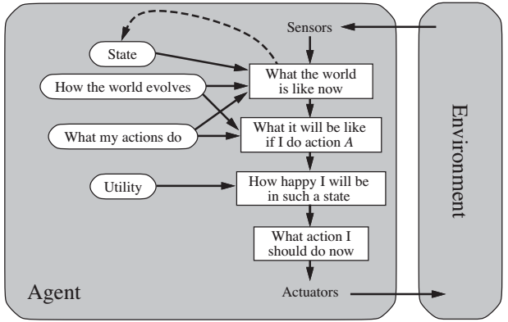
Utility-based agent
Notes:
A model-based, utility-based agent. It uses a model of the world, along with a utility function that measures its preferences among states of the world. Then it chooses the action that leads to the best expected utility, where expected utility is computed by averaging over all possible outcome states, weighted by the probability of the outcome.

Slide 57
Utility-based agent: Advantages
When there are conflicting goals
  Only some of which can be achieved, e.g., speed and safety
  The utility function specifies the appropriate tradeoff.
When there are several goals that the agent can aim for
  None of which can be achieved with certainty
  The utility weights the likelihood of success against the importance of the goals.
The rational utility-based agent chooses the action that maximizes the expected utility of the action outcomes
Notes:
Furthermore, in two kinds of cases, goals are inadequate but a utility-based agent can still make rational decisions.
The utility the agent expects to derive, on average, given the probabilities and utilities of each outcome.

Slide 58
Learning agents
After an agent is programmed, can it work immediately?
  No, it still need teaching
Once an agent is done, what can we do next?
  Teach it by giving it a set of examples
  Test it by using another set of examples
We then say the agent learns → learning agents

Slide 59
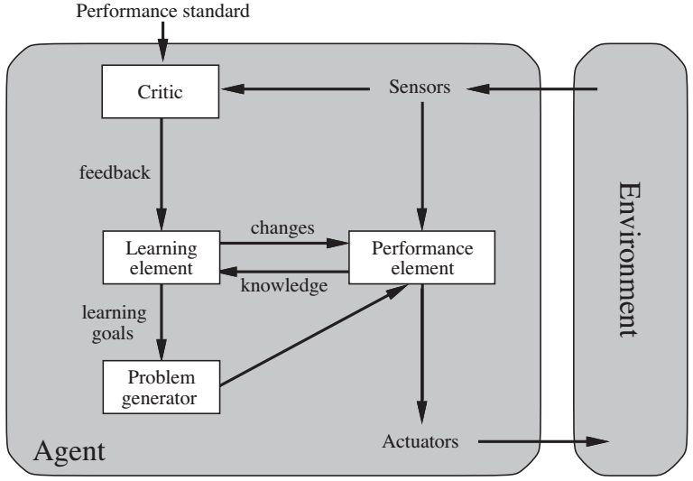
Learning agents
Notes:
The performance element is what we have previously considered to be the entire agent: it takes in percepts and decides on actions.
The learning element uses feedback from the critic on how the agent is doing and determines how the performance element should be modified to do better in the future.
The design of the learning element depends very much on the design of the performance element.

Slide 60
Learning agents
A learning agent is divided into four conceptual components
  Learning element → Making improvement
  Performance element → Selecting external actions
  Critic → Tells the Learning element how well the agent is doing with respect to fixed performance standard. (Feedback from user or examples, good or not?)
  Problem generator → Suggest actions that will lead to new and informative experiences
Learning in intelligent agents is a process of modification of each component of the agent to bring the components into closer agreement with the available feedback information, thereby improving the overall performance of the agent.
Notes:
if the agent is willing to explore a little and do some perhaps suboptimal actions in the short run, it might discover much better actions for the long run
In summary, agents have a variety of components, and those components can be represented in many ways within the agent program, so there appears to be great variety among learning methods. There is, however, a single unifying theme.

Slide 61
Learning agents: An example
Performance element
  Whatever collection of knowledge and procedures the taxi has for selecting its driving actions (may be further modified)
Critic
  Observe the world and pass information to the learning element
  E.g., quick left turn across three lanes of traffic → shocking language used by other drivers observed → bad action
Learning element
  Formulate new rules from the experience told by the critic
  E.g., a new rule for the above bad action
Problem generator
  Identify certain areas of behavior in need of improvement and suggest experiments, e.g., trying out the brakes on different road surfaces under different conditions
Notes:
To make the overall design more concrete, let us return to the automated taxi example.
The performance element consists of whatever collection of knowledge and procedures the taxi has for selecting its driving actions. The taxi goes out on the road and drives, using this performance element.
The critic observes the world and passes information along to the learning element. For example, after the taxi makes a quick left turn across three lanes of traffic, the critic observes the shocking language used by other drivers. From this experience, the learning element is able to formulate a rule saying this was a bad action, and the performance element is modified by installation of the new rule.
The problem generator might identify certain areas of behavior in need of improvement and suggest experiments, such as trying out the brakes on different road surfaces under different conditions.

Slide 62
Quiz: Learning agents
Give an example of learning rational agent following four conceptual elements

Slide 63

THE END

